Slide 1
EFB 390 Recitation – Wednesday 9/28
Announcements: - Population abundance assignment due today - Next assignment posted on Blackboard - Exam Tues. 10/11 (open note)
Today: - Intros - Last minute population abundance work session - What is a habitat?
Notes:
intros: what’s an important component of your habitat?
10 minutes to connect with your group for the population abundance assignment and time to ask me any last minute questions
Discuss habitat, break into groups

Slide 2
Trefethen (1964) - "Habitat is the sum total of the environmental factors, food, cover, and water, that a given species needs to survive and reproduce in a given area.“
Odum - (1971) "the place where an organism lives; where one would go to find it”
Ricklefs (1973) - "the place where a plant or animal normally lives, often characterized by a dominant plant form or physical characteristic."
Noss et al. (1997) - "the multidimensional place where an organism, population, or assemblage of populations lives; the living and non-living surroundings.“
Morrison et al. (1992) - " an area with the combination of resources (like food, cover, water) and the environmental conditions (temperature, precipitation, presence or absence of predators and competitors) that promotes occupancy by individuals of a given species (or population) and allows those individuals to survive and reproduce
Israel Parker
Notes:
2. Odum
…. Sounds like geographical range.
3. Rickliefs
– what the heck does "normally" mean?
4. Noss et al.
This definition:
Recognizes biotic and abiotic elements
Fails to fully consider that some habitats are better than others for a given species
Definition isn’t very detailed
5. Morrison et al.
This definition:
The term “promotes occupancy” works well because it introduces the idea of habitat quality
A vegetation type will be used by a species if that area contains the resources and environmental conditions the species need

Slide 3
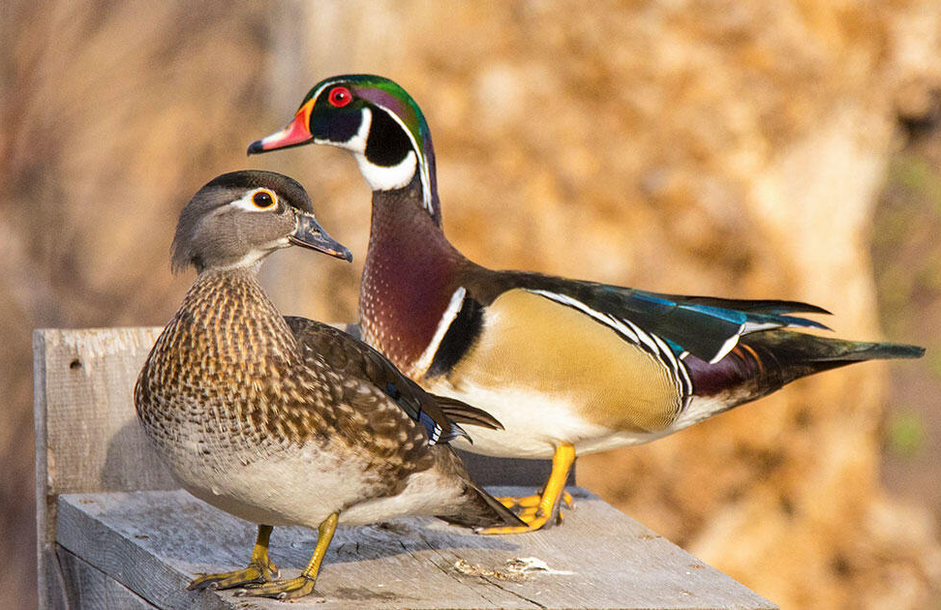
Example: Wood Duck
Wetlands – open water and cover
Food – seeds, fruits, insects
Available nesting cavities – tree cavities/nest boxes number and density
Brood-rearing habitat – dense cover in shallow wetlands with present water
Sousa and Farmer et al. (1983)
Notes:
Wood Ducks thrive in bottomland forests, swamps, freshwater marshes, and beaver ponds. They are also common along streams of all sizes, from creeks to rivers, and the sheer extent of these make them an important habitat. Wood Ducks seem to fare best when open water alternates with 50–75% vegetative cover that the ducks can hide and forage in. This cover can consist of downed trees, shrubs such as alder, willow, and buttonbush, as well as emergent herbaceous plants such as arrowhead and smartweeds.
Food - Wood Ducks eat seeds, fruits, insects and other arthropods. When aquatic foods are unavailable they may take to dry land to eat acorns and other nuts from forests and grain from fields.
Nesting cavities – tree more than 1-2 feet in diameter with a cavity 2-60 ft high (can’t make their own cavities!) use rotted heartwood and occasionally woodpecker cavities
Dead trees are often in short supply

Slide 4
Group Habitats
Each group choose a representative species
Polar, Temperate, Tropical, Marine
Define its habitat:
Food, cover, water
Temperature, precipitation, predators/competition
Others?

Slide 5
Habitat-based conservation
Why focus on managing habitats instead of species?
Habitats represent the biological and environmental interactions part of unique ecosystem (important for longterm preservation)
Protecting habitat → protect non-target species
Habitats are easier to map than species distribution or ecological processes
Monitoring environmental change over time is more meaningful at larger scales

Slide 6
Hall et al. (1997)
“ the resources and conditions present in an area that produce occupancy-including survival and reproduction-by a given organism.”
Ranked based on:
If terms were defined
Inconsistent uses of words
Evaluation of definitions – “correct,” “incorrect,” “weak,” or “poor.”

Slide 7
Hall et al. (1997)
A term was defined similarly to our definition and was used consistently throughout the article
No definition, or an incomplete one, was provided for a term, but the use of the term was similar to our use
No definition for a term was given, or the use of the term fluctuated between being correct and incorrect in the article
Neither of the criteria under “1” was met

